Slide 1
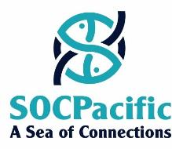
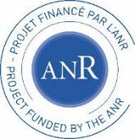
Colloque ‘Le très grand cycle de l’eau’ Continuum Humain - Terre - Mer 13 mai 2022 Continuum terre-mer et gestion 'ridge-to-reef' à Fidji (Pacifique Sud)
Elodie Fache
elodie.fache@ird.fr

Slide 2
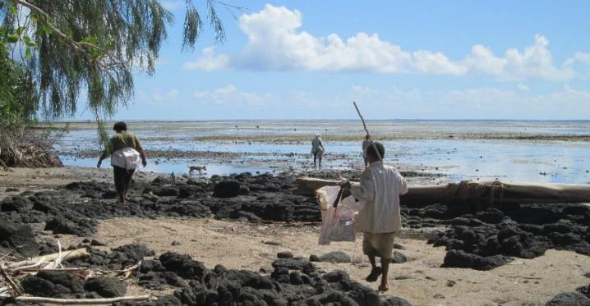
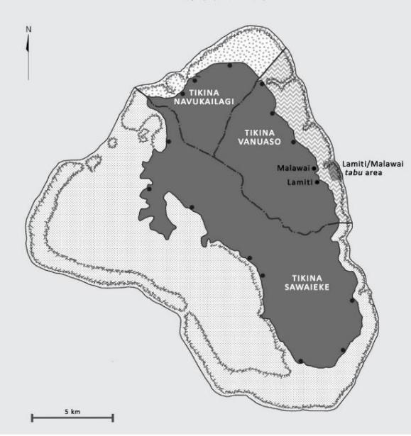
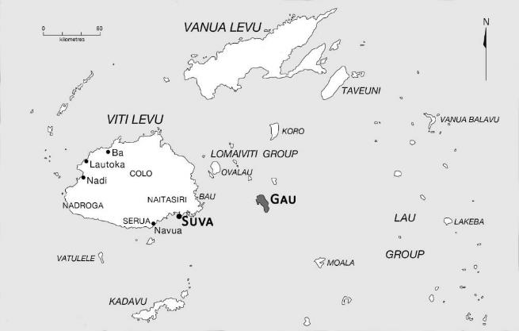
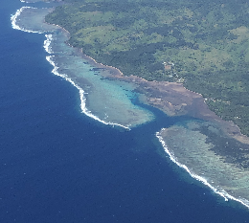
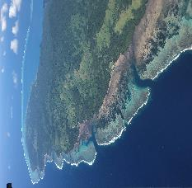
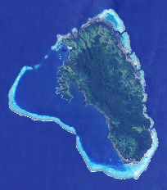
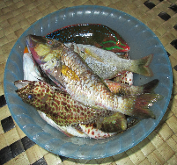
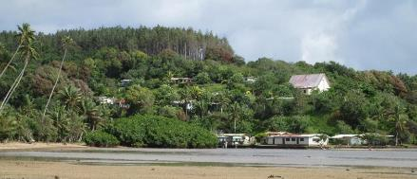
Initiatives de ‘gestion communautaire des ressources marines’ à Fidji
Etude des représentations et pratiques locales dans le cadre de l’initiative Lomani Gau, articulée autour de la superposition entre zone coutumière de pêche (iqoliqoli) et aire marine gérée localement (LMMA) intégrant des ‘tabu areas’

Slide 3
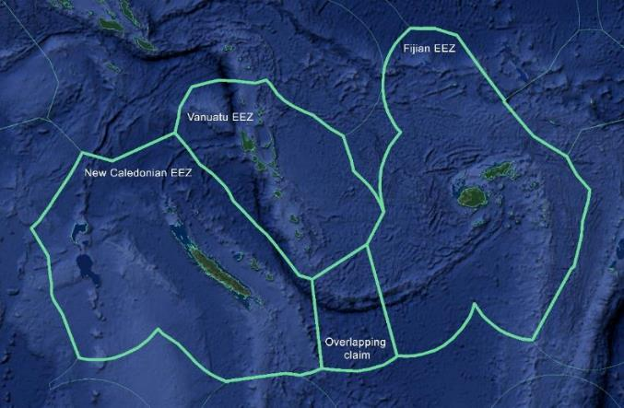
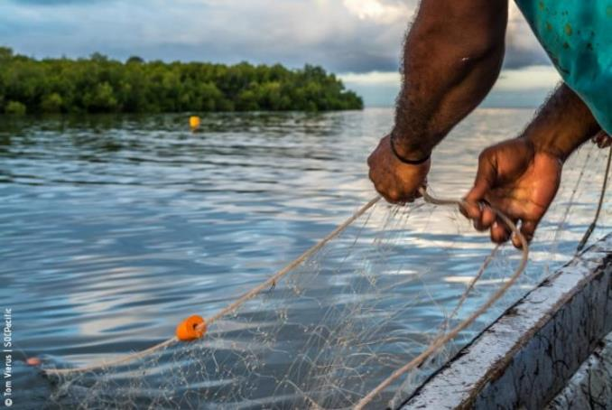
Pêcheries côtières et hauturières dans le Pacifique Sud (Fidji, Nouvelle-Calédonie, Vanuatu)
A Sea of Connections:
Contextualizing Fisheries in the South Pacific Region
Au croisement
entre thématiques 1 & 2 :
Différentes approches des pêcheries côtières / récifales :
Représentations de la mer et pratiques de pêche des enfants
Valeurs des ‘ressources’ côtières
Surpêche
Gestion ridge-to-reef
Connections entre changement climatique, religion et politique
Politiques publiques de gestion des pêcheries
Ruée vers les espaces et ressources du Pacifique Sud
Explorer le vaste champ de connexions
(socio-culturelles, socio-politiques et géopolitiques)
dans le contexte desquelles s’inscrivent les
pratiques de pêche côtières et hauturières et les politiques de gestion de ces pêcheries
1- Valeurs sociales des lieux et des ressources associés aux pêcheries hauturières et côtières
2- Tensions entre enjeux de pêche
et enjeux de conservation
3- Politiques d’inclusion des activités de pêche dans les processus de planification spatiale marine

Slide 4
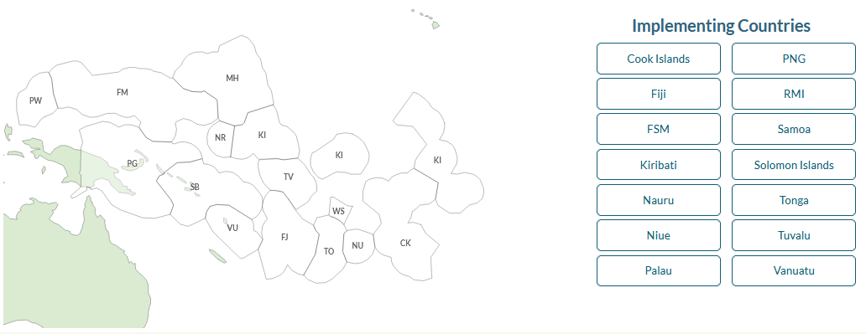
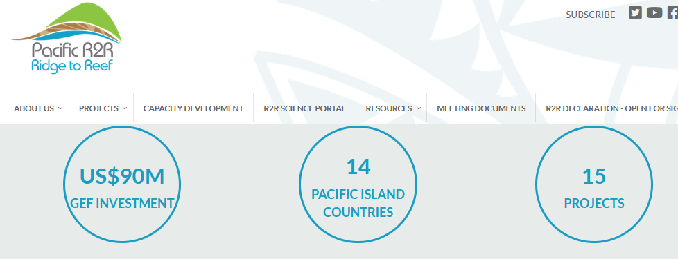
Pacific Ridge to Reef (R2R) Programme - https://www.pacific-r2r.org/

Slide 5
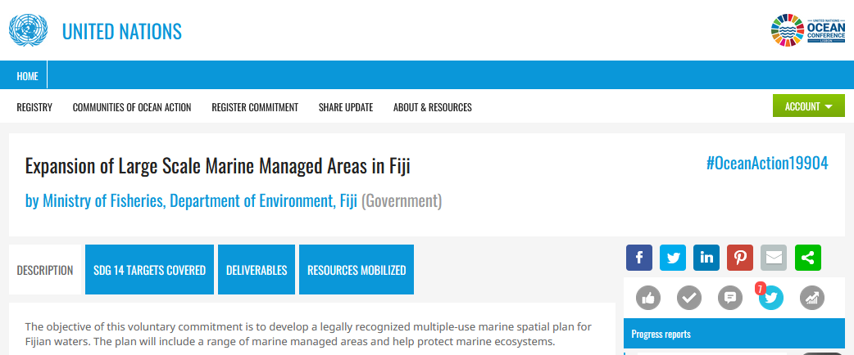
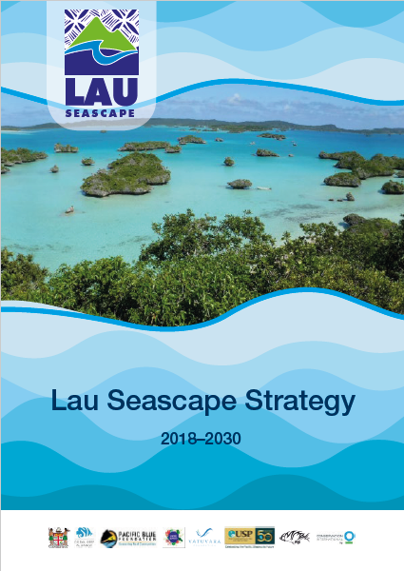
Ridge to Reef (to Ocean) Management - Seascapes
4 Seascapes:
Vatu-i-Ra Seascape
Lau Seascape
Great Sea Reef
Great Astrolabe Reef
Lau Seascape Strategy 2018-2030:
Integrated natural resource management
“from ridge to reef to ocean”
in the Lau Province and its surroundings waters i.e. across about 25% of Fiji’s EEZ

Slide 6
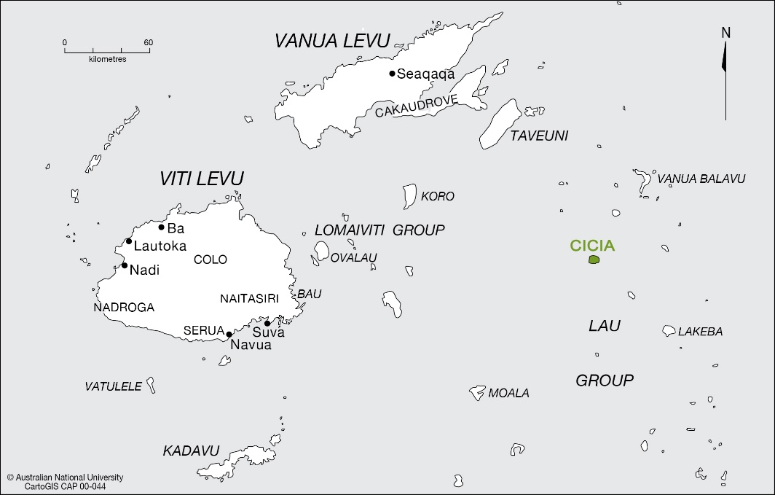
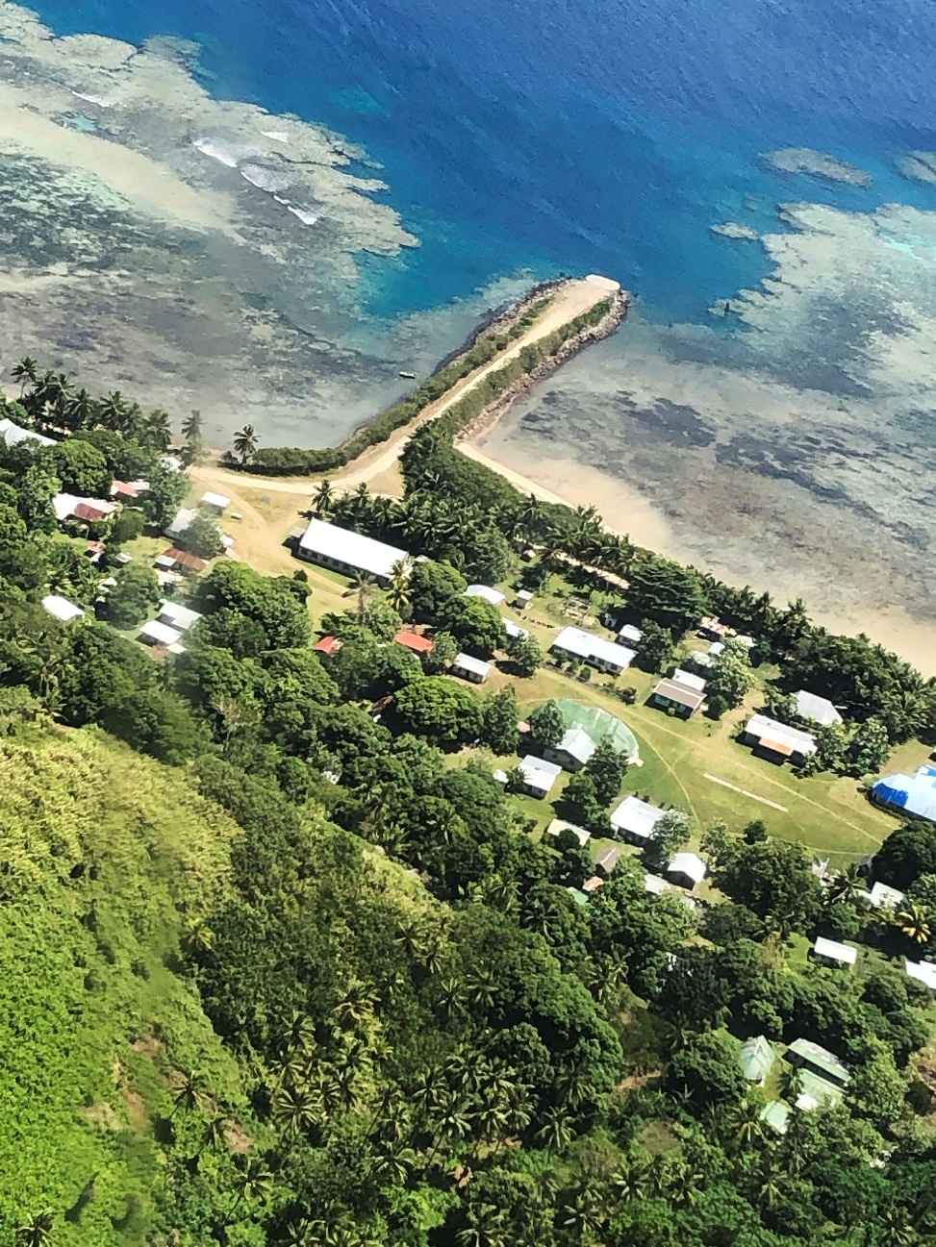
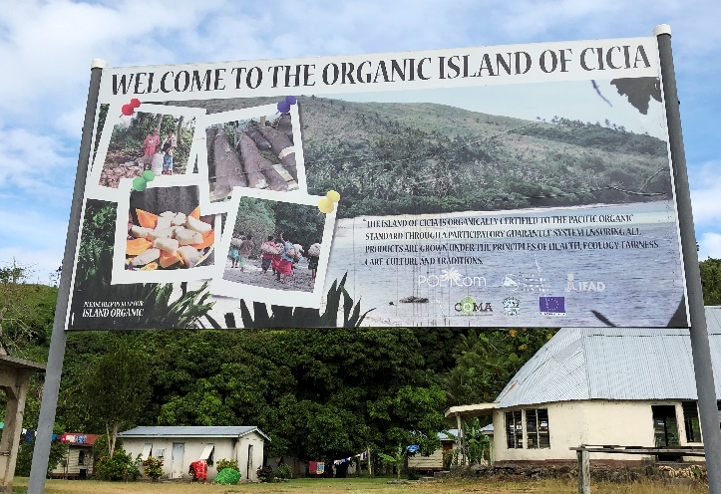
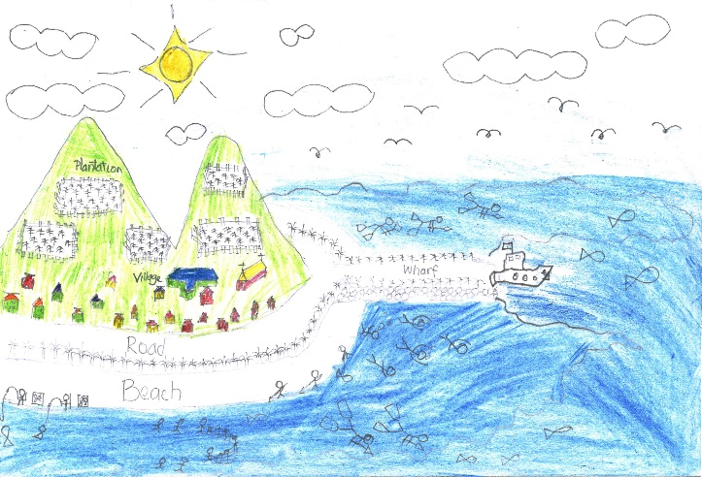
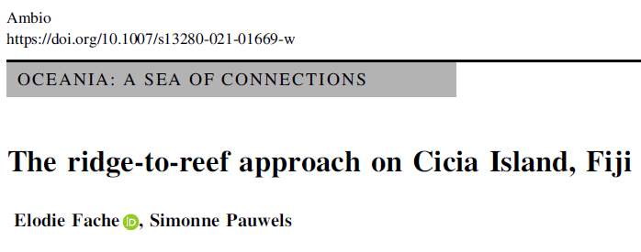
Fidji - Ile de Cicia

Slide 7
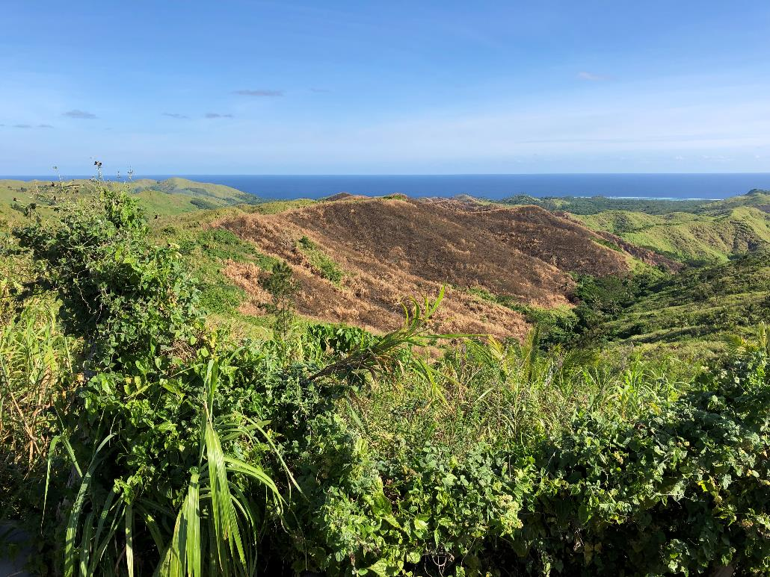
Fidji - Ile de Cicia
L’un des principaux moteurs de la transition vers une ‘organic island’
= épuisement croissant des ressources marines
Interdiction des produits phytosanitaires chimiques pensé comme ayant un impact positif sur les coraux et ressources marines
Brûlage sur terre pensé comme entraînant une raréfaction des poissons dans la mer vs interdiction du brûlage pensé comme entraînant une abondance de poissons
When the land is ‘dry’ (dravu-i-siga), instead of ‘green’ (drokadroka),
the sea is ‘poor and unproductive’ (dravudravua or drava).
When the land is ‘rich’ (sautu – peace, prosperity, abundance),
the sea too is rich (sautu).
“The organic status of your inner being will also affect the organic status of your customary fishing rights area and land.”
(interview in Tarukua, 2 October 2019; translated by Mere Veitayaki)

Slide 8
“Vanua has a literal meaning and a symbolic meaning. Both are inextricably tied together.” (p.33)
Literal meaning (p.33-35):
“Vanua literally means land. In its very broad sweep, it encompasses many things and includes earthly turf, flora, and fauna of a given place, rivers and mountains, fishing ground (vanua ni qoliqoli) and more.
Put simply, it means place. It can also be used for one’s country, district or village. When used in terms of actual turf, it includes practically everything on it. […]
Vanua also refers to people. The populace out of respect are usually described as lewe ni vanua (inner part of the land). Without the people, the vanua is like a body without a soul. […]
Fijian social units to which every member belongs are hierarchical. The smallest unit is the i tokatoka. On top of this is the mataqali and next is the yavusa. A number of yavusa group together to form a vanua, which is a socio-political association bound together and constantly strengthened by social and political ties of one kind or another and paying homage to a leading turaga. Quite often the entire social structure from the bottom to the top of the hierarchy is the making of what we call vanua.”
Symbolic meaning (p.35-50):
A source of life, a mother, a religious symbol, a social fact holding life together and giving it meaning…
Associated with events and time, with traditions and memories of the ancestors…
And providing a reassuring sense of identity
Tuwere I.S. 2002. Vanua: Towards a Fijian Theology of Place. Suva: USP, Institute of Pacific Studies, and College of St John the Evangelist.
“[The vanua] is the place where his ancestors preceded him and in which their spirits or souls linger and watch over the affairs of those who come after them. […] It is an extension of the concept of the self.” (p.70)
Ravuvu A. 1983. Vaka i Taukei: The Fijian way of life. Suva: USP, Institute of Pacific Studies.
“[…] the vanua is physical in nature – including the land, sea, river, mountain, forest and people – and also abstract, a theoretical whole that embraces all people and their relationships with others and with the land, spirits, resources and environment […]” (p.77-78)
Nabobo-Baba U. 2006. Knowing & learning: An indigenous Fijian approach. Suva: USP, IAS.

Slide 9
Vanua : reflets d’une ontologie relationnelle
Poirier, Sylvie. 2008. Reflections on Indigenous Cosmopolitics-Poetics. Anthropologica 50(1): 75‑85.
Ontologie relationnelle :
Les relations – entre humains aussi bien qu’entre humains et non-humains – sont une composante intrinsèque et dynamique des manières locales d’être-au-monde ; elles sont incarnées et constitutives de l’identité des personnes (humaines et non-humaines).
“‘I relate therefore I am’ […] in many ways represents the core of a ‘relational ontology’.”
“Such relations between human and non-human constituents of the dwelt-in world are not extrinsic to one's identity and being. They are embodied, an intrinsic and integral dimension of one's bodily-self […] that connects one meaningfully to the surrounding socio-cosmic environment. Each person is thus a node within networks of agencies, social (but also political and ritual) relations, rights and responsibilities.”
Les non-humains - qu’il s’agisse d’ancêtres, de parents décédés, d’esprits, de lieux, d’animaux, de plantes, de traits du paysage, etc. – sont considérés comme dotés de conscience, d’intentionnalité et de moyens d’action.
“in indigenous understandings and experiences of the world, the agency of non-humans is a fact of life; it is a real and true phenomenon”
Les relations entre humains et non-humains sont donc intersubjectives, réciproques et négociées.
“In a cosmocentric [as opposed to sociocentric or anthropocentric] way of being-in-the world, humans understand their humanity (and thus their difference and positionality) not by creating an ontological divide between nature and culture, but by engaging in manifold relations and negotiation with non-human agencies; not by reducing the field of the social to humans only, but by including non-humans in their sociality.”
Ontologie = Notion polysémique
Ici entendue comme définition de ce qu’est le monde et comment il est constitué + comme manière d’être-au-monde
Les ontologies relèvent à la fois de la cognition et de l’expérience, sont pensées et vécues

Slide 10
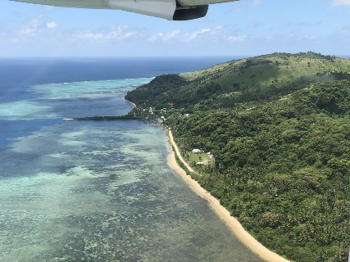
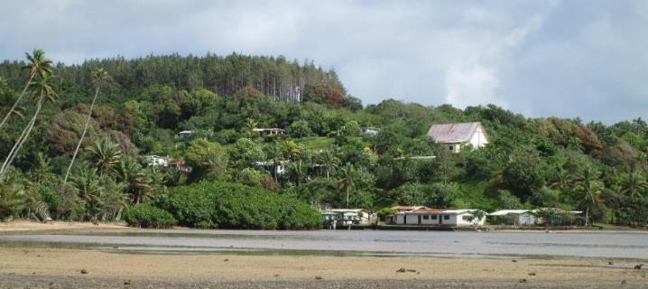
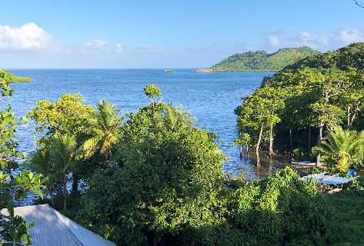
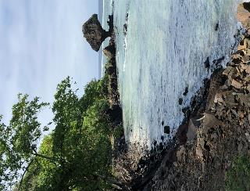
Vanua : reflets d’une ontologie relationnelle
Vanua = territoire terre-mer
+ tous les humains et non-humains
qui y co-habitent et le co-façonnent
qui sont interconnectés et s’affectent mutuellement
“Chief, people, and land [incl. fishing ground] have close relationship so that if one is affected the whole suffers.” (p.27)
Tuwere I.S. 2002. Vanua: Towards a Fijian Theology of Place. Suva: USP, Institute of Pacific Studies, and College of St John the Evangelist.
“[T]he world is one big entity and all things in it are associated. Life is complete and wholesome when all elements – air, wind, seas, rivers, plants, animals, fishes, people, the dead – are ‘synchronized’. […] In this view, life and its vitality depend on how all things relate and are affected by each other.” (p.42)
Nabobo-Baba U. 2006. Knowing & learning: An indigenous Fijian approach. Suva: USP, IAS

